Slide 1
Welcome to Our Presentation of
PYTHON
By
MD BORQAT ALI
And
GOLAM AZAM
Department of Statistics, RU

Slide 2
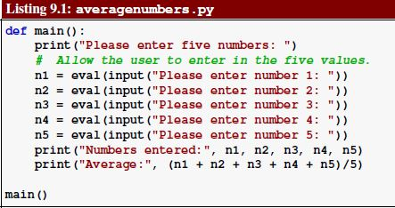
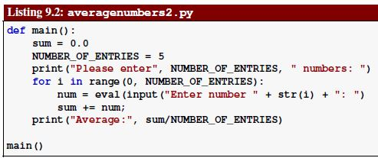

Slide 3

Lists: A List is a kind of Collection of objects.
A collection allows us to put many values in a single “variable”
A collection is nice because we can carry all many values around in one convenient package.
friends = ['Jusi', ‘Miraj', ‘Harun']]
carryon = [ 'socks', 'shirt', 'perfume' ]

Slide 4
friends = ['Jusi', ‘Miraj', ‘Harun']
for friend in friends :
print ('Happy New Year:', friend)
print ('Done!‘)

Slide 5
List Constants
List constants are surrounded by square brakets and the elements in the list are separated by commas.
A list element can be any Python object - even another list
A list can be empty
>>> print ([1, 24, 76])
[1, 24, 76]
>>> print (['red', 'yellow', 'blue'])
['red', 'yellow', 'blue']
>>> print (['red', 24, 98.6])
['red', 24, 98.599999999999994]
>>> print([ 1, [5, 6], 7])
[1, [5, 6], 7]
>>> print([])
[]

Slide 6
Lists are Mutable
>>> fruit = 'Banana’
>>> fruit[0] = 'b’
Traceback
TypeError: 'str' object does not
support item assignment
>>> x = fruit.lower()
>>> print x
banana
>>> lotto = [2, 14, 26, 41, 63]
>>> print (lotto[2, 14, 26, 41, 63])
>>> lotto[2] = 28
>>> print( lotto)
[2, 14, 28, 41, 63]
Strings are "immutable" - we cannot change the contents of a string - we must make a new string to make any change
Lists are "mutable" - we can change an element of a list using the index operator

Slide 7
Concatenating lists using +
We can create a new list by adding two exsiting lists together
>>> a = [1, 2, 3]
>>> b = [4, 5, 6]
>>> c = a + b
>>> print c
[1, 2, 3, 4, 5, 6]
>>> print a
[1, 2, 3]

Slide 8
Aliasing
However, if we assign one variable to another:
So this time the memory state picture is:
More importantly, changing b also changes a
a = [1, 2, 3] b = a print id(a), id(b) 135023431 135023431
a b
[1, 2, 3]
b[0] = 0 print a [0, 2, 3]

Slide 9
Lists are like:
my wallet
my wife’s purse
[1, 2, 3]
Money:
Or also Credit Cards:
[1, 2, 3]
me
my wife
[1, 2, 3]

Slide 10
List Operations:
a = [1, 2, 3] b = [4, 5, 6] c = a + b print c [1, 2, 3, 4 ,5, 6]
Concatenating lists using +
Add two lists:
Repeat a list many times:
Exercise: Create a list of 20 zeros.
a = [1, 2, 3] print a*3 [1, 2, 3, 1, 2, 3, 1, 2, 3]
zeros = [0]*20

Slide 11
List Operations
Method | Meaning
<list>.append(x) | Add element x to end of list.
<list>.sort() | Sort (order) the list. A comparison function may be passed as a parameter.
<list>.reverse() | Reverse the list.
<list>.index(x) | Returns index of first occurrence of x.
<list>.insert(i, x) | Insert x into list at index i.
<list>.count(x) | Returns the number of occurrences of x in list.
<list>.remove(x) | Deletes the first occurrence of x in list.
<list>.pop(i) | Deletes the ith element of the list and returns its value.

Slide 12
List Operations
>>> lst = [3, 1, 4, 1, 5, 9]
>>> lst.append(2)
>>> lst
[3, 1, 4, 1, 5, 9, 2]
>>> lst.sort()
>>> lst
[1, 1, 2, 3, 4, 5, 9]
>>> lst.reverse()
>>> lst
[9, 5, 4, 3, 2, 1, 1]
>>> lst.index(4)
2
>>> lst.insert(4, "Hello")
>>> lst
[9, 5, 4, 3, 'Hello', 2, 1, 1]

Slide 13
>>> lst.count(1)
2
>>> lst.remove(1)
>>> lst
[9, 5, 4, 3, 'Hello', 2, 1]
>>> lst.pop(3)
3
>>> lst
[9, 5, 4, 'Hello', 2, 1]

Slide 14
9.4 Slicing
We can make a new list from a portion of an existing list using a technique known as slicing. A list slice is an expression of the form
list [ begin : end ]
where
• list is a list—a variable referring to a list object, a literal list, or some other expression that evaluates to a list,
• begin- is an integer representing the starting index of a subsequence of the list, and
• end- is an integer that is one larger than the index of the last element in a subsequence of the list.

Slide 15
Lists can be sliced using :
>>> t = [9, 41, 12, 3, 74, 15]
>>> t[1:3]
[41,12]
>>> t[:4]
[9, 41, 12, 3]
>>> t[3:]
[3, 74, 15]
>>> t[:]
[9, 41, 12, 3, 74, 15]
Remember: Just like in strings, the second number is "up to but not including"

Slide 16
Best Friends: Strings and Lists
>>> abc = 'With three words’
>>> stuff = abc.split()
>>> print( stuff)
['With', 'three', 'words']
>>> print( len(stuff))
3
>>> print stuff[0]
With
>>> print (stuff)
['With', 'three', 'words']
>>> for w in stuff :
... print w
...
With
Three
Words
>>>
Split breaks a string into parts produces a list of strings. We think of these as words. We can access a particular word or loop through all the words.

Slide 17
>>> line = 'A lot of spaces’
>>> etc = line.split()
>>> print etc['A', 'lot', 'of', 'spaces']
>>>
>>> line = 'first;second;third’
>>> thing = line.split()
>>> print thing['first;second;third']
>>> print len(thing)
1
>>> thing = line.split(';')
>>> print thing['first', 'second', 'third']
>>> print len(thing)
3
>>>
When you do not specify a delimiter, multiple spaces are treated like “one” delimiter.
You can specify what delimiter character to use in the splitting.

